Slide 1

Introduction
KT44502 DISTRIBUTED SYSTEM
Semester 1 2022/2023

Slide 2
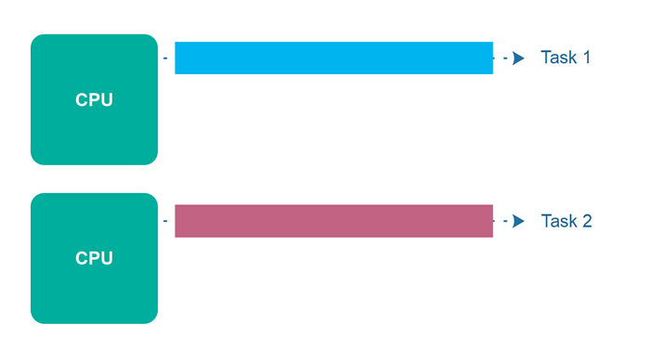
Parallel
A parallel computer is a type of computer that uses multiple processors or cores to perform tasks simultaneously. This allows the computer to perform multiple tasks at the same time and can potentially improve the speed and performance of certain types of computations. Parallel computers can be useful for a variety of applications, including scientific simulations, data analysis, and machine learning.
A parallel computer is a computer system that uses multiple processing elements simultaneously in a cooperative manner to solve a computational problem
Parallel processing includes techniques and technologies that make it possible to compute in parallel
Hardware, networks, operating systems, parallel libraries, languages, compilers, algorithms, tools, …
Parallel computing is an evolution of serial computing
Parallelism is natural
Computing problems differ in level / type of parallelism

Slide 3
Concepts
Parallel computer - A multiple-processor computer system that supporting parallel programming and computation.
Parallel Computing - The use of parallel computer to reduce the time needed to solve a single computational problem.
Parallel Programming – Computer programming in a language that allows programmers to indicate how different portions of computation may be executed concurrently by different processors.

Slide 4
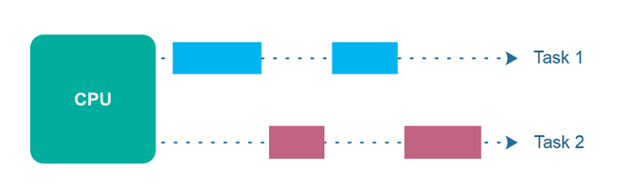
Concurrency
Consider multiple tasks to be executed in a computer
Tasks are concurrent with respect to each if
They can execute at the same time (concurrent execution) Implies that there are no dependencies between the tasks
Dependencies
If a task requires results produced by other tasks in order to execute correctly, the task’s execution is dependent
If two tasks are dependent, they are not concurrent Some form of synchronization must be used to enforce (satisfy) dependencies
Concurrency is fundamental to computer science
Operating systems, databases, networking, …
Task need results from others task=dependent
Dependent=no concurrent

Slide 5
Concurrency and Parallelism
Refer to related but different things.
Concurrent (multiple threads control, thread x run in parallel)
A concurrent program has multiple logical threads of control. These threads may or may not run in parallel.
Parallel
(run fast = executing diff part of computation in parallel)
A parallel program potentially runs more quickly than a sequential program by executing different parts of the computation simultaneously (in parallel).
It may or may not have more than one logical thread of control.

Slide 6
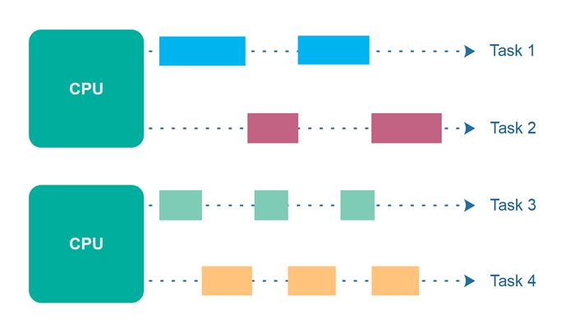
Parallel Concurrent Execution
Making progress on more than one task seemingly at the same time on more than on CPU.
Concurrent is not the same as parallel!
Why?
Parallel execution:
Concurrent tasks execute at the same time
Multiple (processing) resources must be available
Concurrency =computer program or system to handle multiple tasks at the same time//multiple processors or cores, or by using a single processor to switch rapidly between tasks
Parallelism, on the other hand, refers specifically to the execution of multiple tasks simultaneously, using multiple processors or cores
Notes:
Concurrency refers to the ability of a computer program or system to handle multiple tasks at the same time. This can be achieved in a number of ways, such as by using multiple processors or cores, or by using a single processor to switch rapidly between tasks. Concurrency allows a program to make progress on multiple tasks simultaneously, but it does not necessarily mean that the tasks are executed at the same time.
Parallelism, on the other hand, refers specifically to the execution of multiple tasks simultaneously, using multiple processors or cores. In other words, parallelism is a type of concurrency that involves the actual simultaneous execution of multiple tasks. Parallelism is a more efficient way of executing tasks than concurrency, because it allows a program to take advantage of multiple processors or cores to execute tasks simultaneously.
In short, concurrency is a broader concept that refers to the ability of a program or system to handle multiple tasks at the same time, while parallelism is a specific type of concurrency that involves the simultaneous execution of multiple tasks.

Slide 7
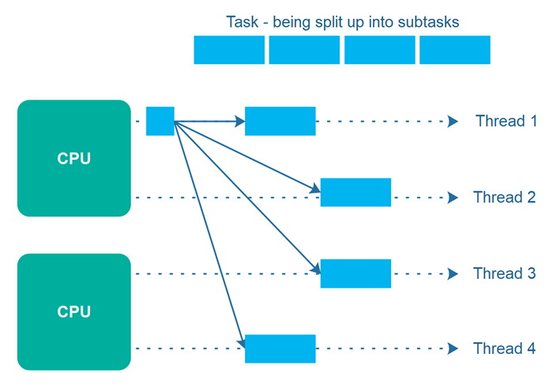
Parallelism
An application splits its tasks up into smaller subtasks which can be processed in parallel, for instance on multiple CPUs at the exact same time.
There are granularities of parallelism (parallel execution) in programs
Processes, threads, routines, statements, instructions, …
Think about what are the software elements that execute concurrently
These must be supported by hardware resources
Processors, cores, … (execution of instructions)
Memory, DMA, networks, … (other associated operations)
All aspects of computer architecture offer opportunities for parallel hardware execution
Concurrency is a necessary condition for parallelism

Slide 8
Concurrency and Parallelism
Running parallel threads of execution is important
Making use of parallelism implies concurrency
Multiple actions running at the same time
Or executed, or appears to do certain tasks
This can be difficult
Two tasks or executions that may depends on the other executions
Thus, parallelism will make the execution order is non-deterministic
If it not controlled (synchronized), output could be different and intractable

Slide 9
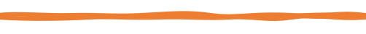
Concurrency vs. Parallelism
Concurrent execution on a single-core system:
Parallel execution on a dual-core system:
Core 1
P1 | P2 | P3 | P4 | P1 | P2 | P3 | P4 | P1 | …
Time
Core 1
P1 | P3 | P1 | P3 | P1 | P3 | P1 | P3 | P1 | …
Core 2
P2 | P4 | P2 | P4 | P2 | P4 | P2 | P4 | P2 | …
Time

Slide 10
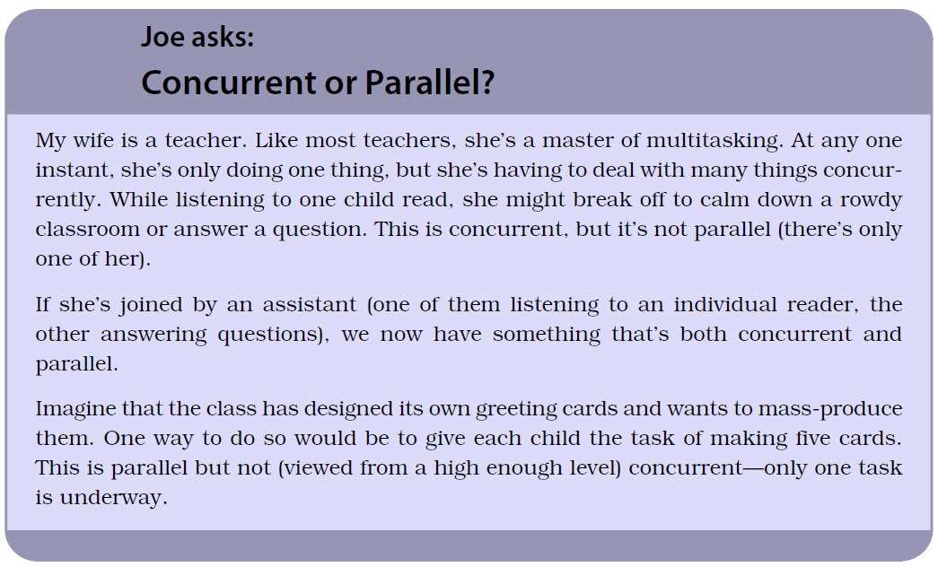

Slide 11


Other examples
In juggling a 3 balls by a person
How is it performed?
In construction of houses or buildings
What tasks?
In manufacturing
What example?
In customer service such as call center
How parallel is achieved?

Slide 12
Activity
Give your own example, each for concurrent and parallel application/process
When is it become concurrent and parallel?
Questions
Is a parallel application a concurrent application?
Is a parallel application run with one processor parallel? Why or why not?
Where can you find concurrency?
How is concurrency expressed to exploit parallel systems?

Slide 13
Why Parallel Processing?
Two primary reasons (both performance related)
Faster time to solution (response time)
Solve bigger computing problems (in same time)
Other factors motivate parallel processing
Effective use of machine resources Cost efficiencies
Overcoming memory constraints
Serial machines have inherent limitations
Processor speed, memory bottlenecks, … Parallelism has become the future of computing Performance is still the driving concern

Slide 14
Why Parallel Processing?
Year | Processor Name | Clock speed
1981 | IBM PC | 5 MHz
1995 | Pentium | 100 MHz
2002 | Pentium 4 | 3000 MHz (3 GHz)
2007 |  | 3800 MHz (3.8 GHz)
2009 |  | 4000 MHz (4.0 GHz)
Moore's law is the observation that the number of transistors in a dense integrated circuit doubles about every two years.
Fabrication process size (“gate pitch”) has fallen from 65 nm, to 45 nm, to 32 nm, to 22 nm, to 16 nm, to 11 nm, to 8 nm, to 7 nm, to 5 nm, to 4 nm. This translates to more transistors on the same size die.
From 1986 to 2002, processor performance increased an average of 52%/year, but then virtually plateaued.

Slide 15
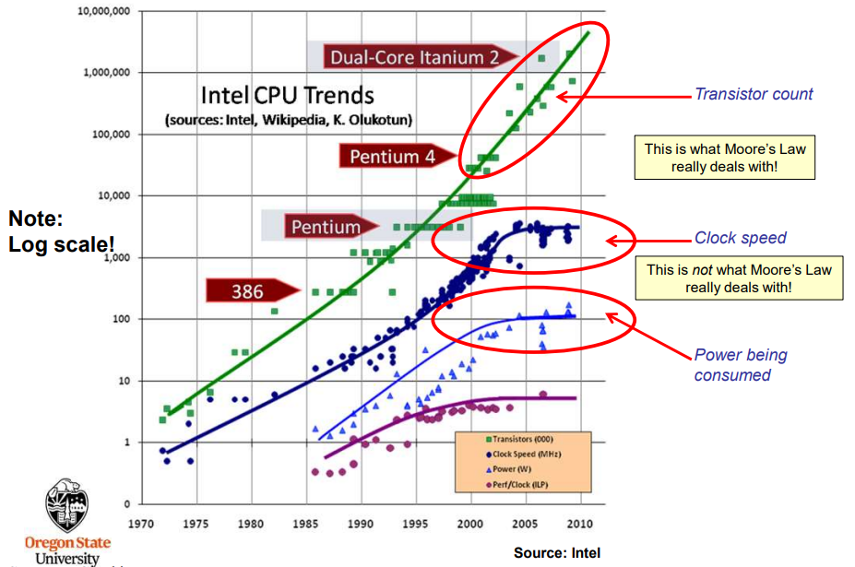
Why Parallel Processing?

Slide 16
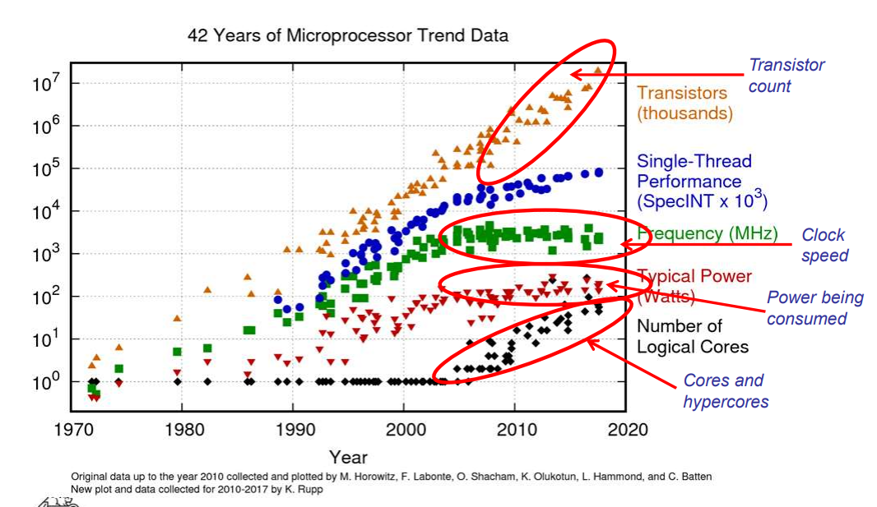
Why Parallel Processing?

Slide 17

And, speaking of “exotic”, AMD set the world record for clock speed (8.429 GHz) using a Liquid Nitrogen-cooled CPU
https://www.youtube.com/watch?v=UKN4VMOenNM&ab_channel=AMDUnprocessed

Slide 18

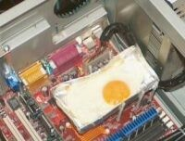
What has happened in the last several years?
Processing chip manufacturers increased processor performance by increasing CPU clock frequency
Riding Moore’s law
Until the chips got too hot!
Greater clock frequency = greater electrical power
Pentium 4 heat sink = Frying an egg on a Pentium 4
Add multiple cores to add performance
Keep clock frequency same or reduced
Keep lid on power requirements

Slide 19
Thank You
Next: Parallel Computer Architecture

